Slide 1
19PHY102 Engineering Physics B Unit V : Solid State Physics

Slide 2
Objectives
Importance of solid state physics in the current world
To describe the arrangements in crystalline solids based on lattice, basis, and crystal structure
Learn the point Co-ordinates, Directions and Planes in a cubic crystal system

Slide 3
Solid state physics, also known as condensed matter physics, is the study of the behavior of atoms when they are placed in close proximity to one another.

Slide 4
What is the point of studying solid state physics ?
Understanding the electrical properties of solids is right at the heart of modern society and technology.
The entire computer and electronics industry relies on tuning of a special class of material, the semiconductor, which lies right at the metal-insulator boundary.
Solid state physics provide a background to understand what goes on in metals, semiconductors and insulators

Slide 5
What is the point of studying solid state physics ?
Solid state physics(SSP) is the applied physics • New technology for the future will inevitably involve developing and understanding new classes of materials.

Slide 6
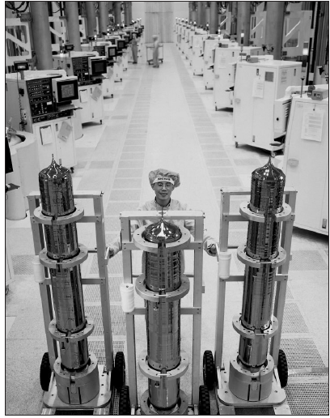

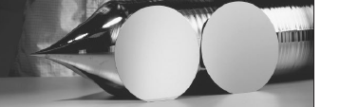
What is the point of studying solid state physics ?
Silicon crystal ingots and
200 mm Si wafers
A multipurpose Si Photonics Process Core

Slide 7
What is the point of studying solid state physics ?
A detector structure that will be used to detect dark matter particles. Each individual cylindrical detector has a CaWO₄ single crystal,
similar to that shown on the bottom right. These crystals are called scintillators, and convert high-energy radiation to light

Slide 8
Solids
Crystal
Non-Crystalline
(Amorphous)
Single Crystal
Polycrystalline

Slide 9
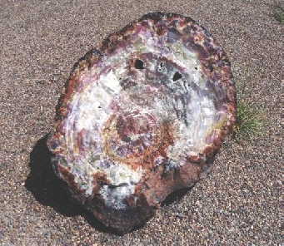
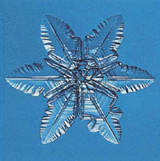
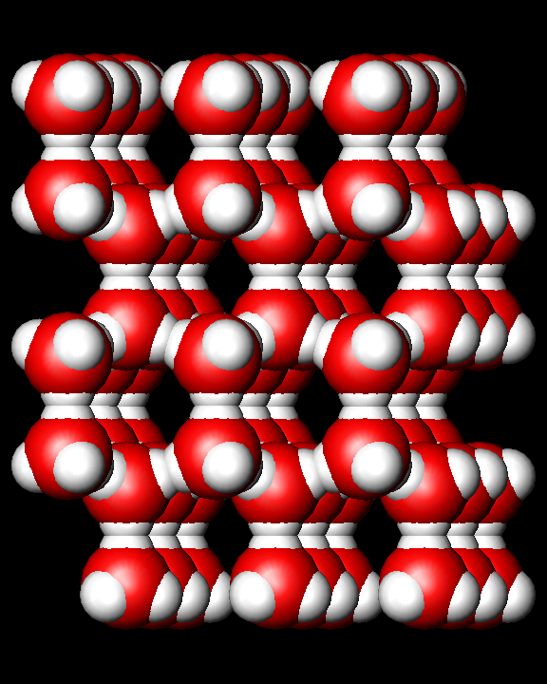
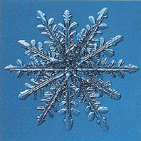
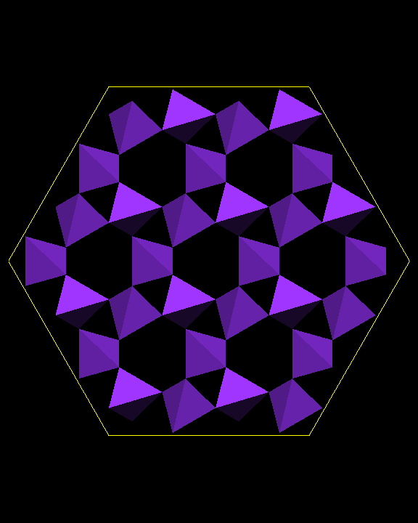
Crystals are Everywhere!

Slide 10
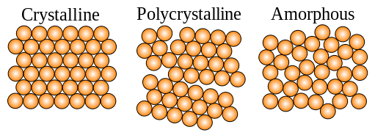
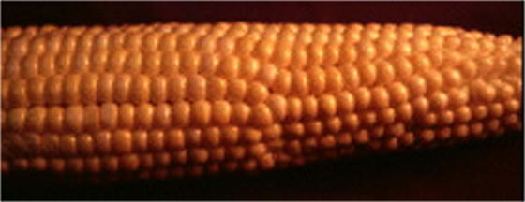
Crystals
Crystals are solids that consist of a periodic array of atoms, ions, or molecules
periodicity is preserved over “large” (macroscopic) distances the solid has “Long-range Order”

Slide 11
Crystals
A crystalline material has directional properties
A crystal has a sharp melting point
It possesses a regular shape and if it is broken, all broken pieces have the same regular shape.
Examples
Metallic crystals – Cu, Ag, Al, Mg etc.
Non-metallic crystals – Carbon, Silicon, Germanium etc.

Slide 12
Non -Crystalline
Amorphous solids do not have Long-Range Order
Short Range Order

Slide 13
Non -Crystalline
They do not have directional properties and so they are called as `isotropic’
substances.
They have wide range of melting point and do not possess a regular shape.
Examples:
Glass, Plastics, Rubber etc.

Slide 14
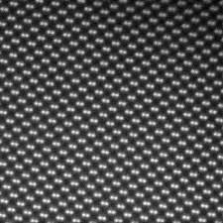
Single Crystal
Single Crystals, ideally have a high degree of order, or regular geometric periodicity, throughout the entire volume of the material
Si (110)

Slide 15
Polycrystalline Solids
A Polycrystalline Solid is made up of an aggregate of many small single crystals (crystallites or grains)
Polycrystalline materials have a high degree of order over many atomic or molecular dimensions. These ordered regions, or single crystal regions, vary in size & orientation with respect to one another. These regions are called grains (or domains) & are separated from one another by grain boundaries.

Slide 16
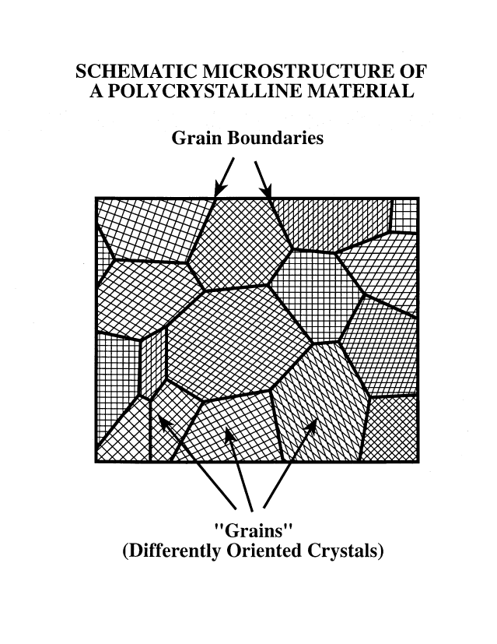
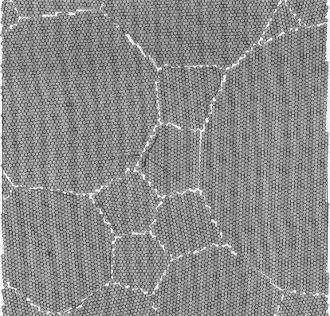
Polycrystalline Solids
The grains are usually 100 nm - 100 microns in diameter
Polycrystals with grains that are < 100 nm in diameter are called nanocrystallites

Slide 17
Crystals
The periodic array of atoms, ions, or molecules that form the solid is called Crystal Structure
Crystal Structure =
Space (Crystal) Lattice + Basis
Space Lattice is a regular periodic arrangement of points in space, and is purely mathematical abstraction
Crystal Structure is formed by “putting” the identical atoms (group of atoms) in the points of the space lattice This group of atoms is the Basis

Slide 18
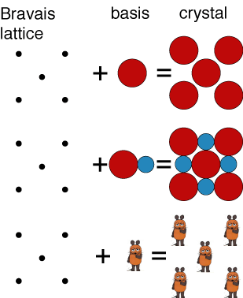
A Two-Dimensional (Bravais) Lattice with Different Choices for the Basis

Slide 19
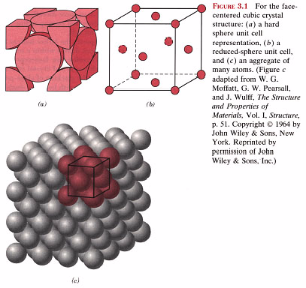
Unit Cell
The unit cell is the smallest structural unit or building block that can describe the crystal structure.
Repetition of the unit cell generates the entire crystal
Unit Cell
Crystal Structure

Slide 20
Primitive Cell
A primitive cell of a particular crystal structure is the smallest possible unit cell one can construct
One lattice point ( one atom)

Slide 21
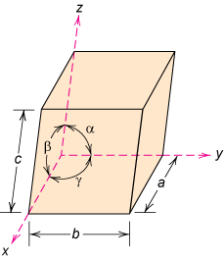
Crystal Systems
There are 14 Bravais Lattice in three dimension.
Unit cell: smallest repetitive volume which contains the complete lattice pattern of a crystal.
7 crystal systems of varying symmetry are known
These systems are built by changing the lattice parameters: a, b, and c are the edge lengths
α, β, and γ are interaxial angles

Slide 22
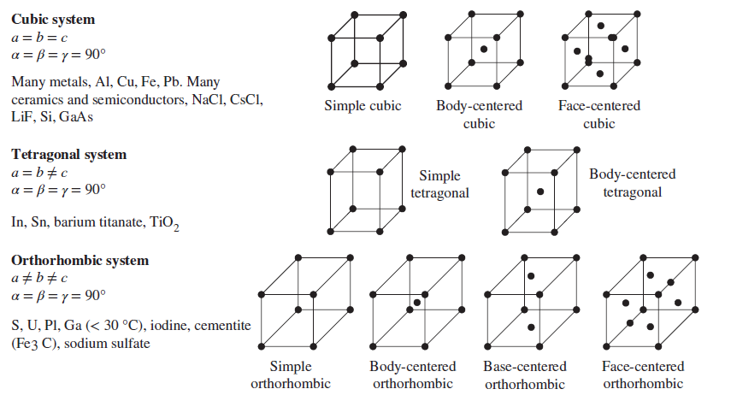
Seven crystal systems and fourteen Bravais lattices

Slide 23
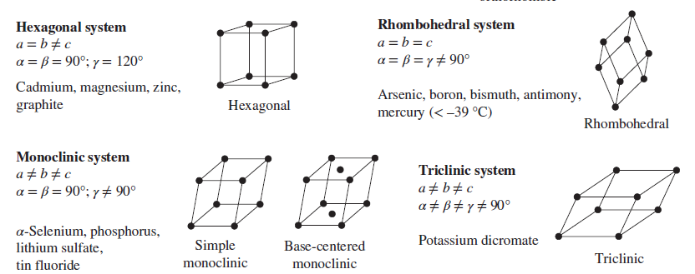
Seven crystal systems and fourteen Bravais lattices

Slide 24
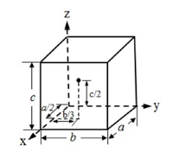
Point Coordinates
Position of any point in a unit cell is given by its coordinates
or distances from the x, y and z axes in terms of the lattice vectors a, b and c.
Thus the point located at a/2 along x axis, b/3 along y axis
and c/2 along z axis, as shown in the figure below, has the coordinates 1/2, 1/3,1/2

Slide 25
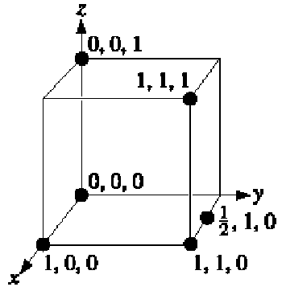
Point Coordinates

Slide 26
Crystal Directions
The directions in a crystal are given by specifying the
coordinates (u, v, w) of a point on a vector (r_{uvw}) passing
through the origin.
r_{uvw} = ua + vb + wc.
It is indicated as [uvw].
For example, the direction [110] lies on a vector r₁₁₀
whose projection lengths on x and y axes are one unit
(0,0,0)
[110]
(1,1,0)

Slide 27
Crystal Directions
To determine a direction of a line in the crystal:
Find the coordinates of the two ends of the line and
subtract the coordinates (Head – Tail) OR draw a line from
the origin parallel to the line and find its projection lengths on
x, y and z axis in terms of the unit vectors a, b and c.
Convert fractions, if any, in to integers and reduce to
lowest term.
Enclose in square brackets [uvw]

Slide 28
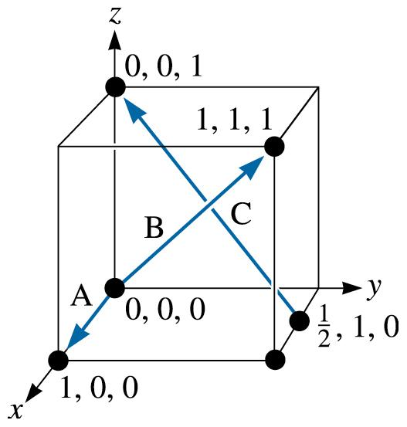
Crystal Directions
Determine the Miller indices of directions A, B, and C

Slide 29
Crystal Directions
Direction A
1. Two points are 1, 0, 0, and 0, 0, 0
2. 1, 0, 0, -0, 0, 0 = 1, 0, 0
3. No fractions to clear or integers to reduce
4. [100]
Direction B
1. Two points are 1, 1, 1 and 0, 0, 0
2. 1, 1, 1, -0, 0, 0 = 1, 1, 1
3. No fractions to clear or integers to reduce
4. [111]
Direction C
1. Two points are 0, 0, 1 and 1/2, 1, 0
2. 0, 0, 1 -1/2, 1, 0 = -1/2, -1, 1
3. 2(-1/2, -1, 1) = -1, -2, 2
Vector:
Head - Tail

Slide 30
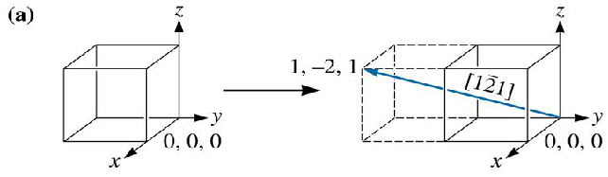
Crystal Directions
Drawing Direction
Draw the directionin a cubic unit cell.
Because we know that we will need to move in the negative y-direction, let’s locate the origin at 0, +1, 0. The ‘‘tail’’ of the direction will be located at this new origin.
A second point on the direction can be determined by moving +1 in the x-direction, 2 in the y-direction, and +1 in the z direction

Slide 31
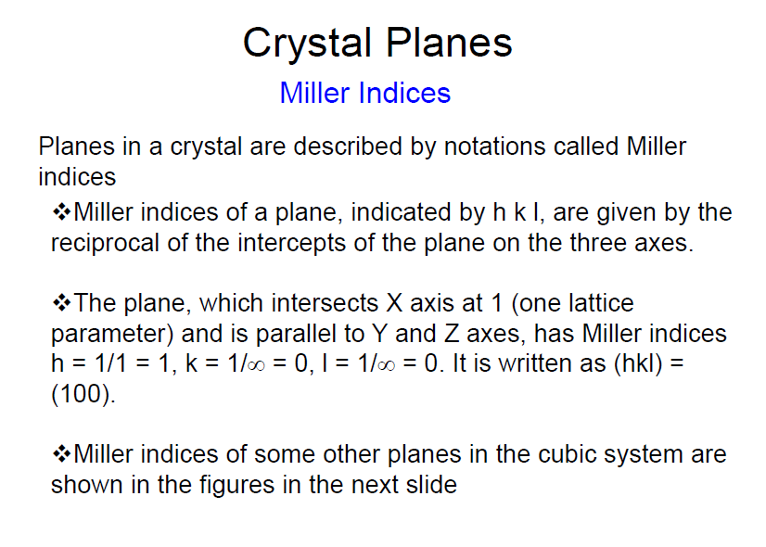

Slide 32
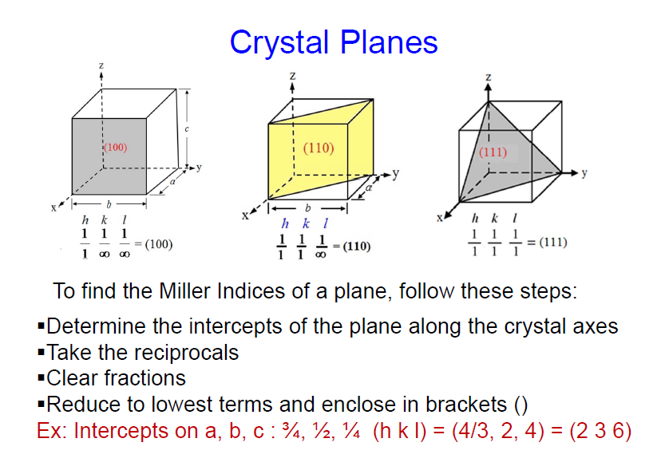

Slide 33
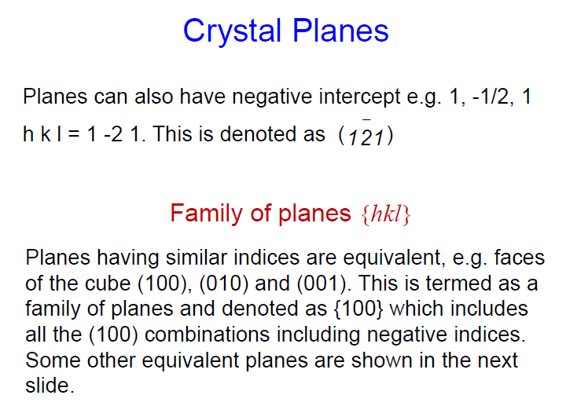

Slide 34
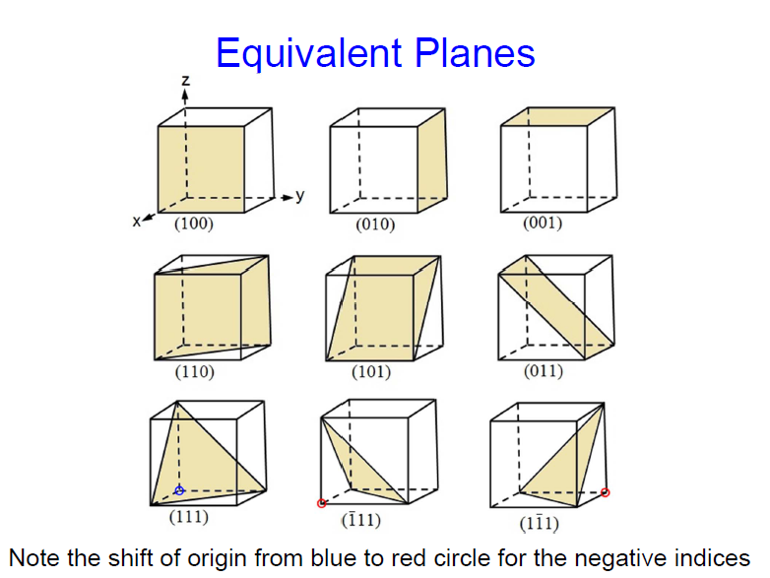

Slide 35
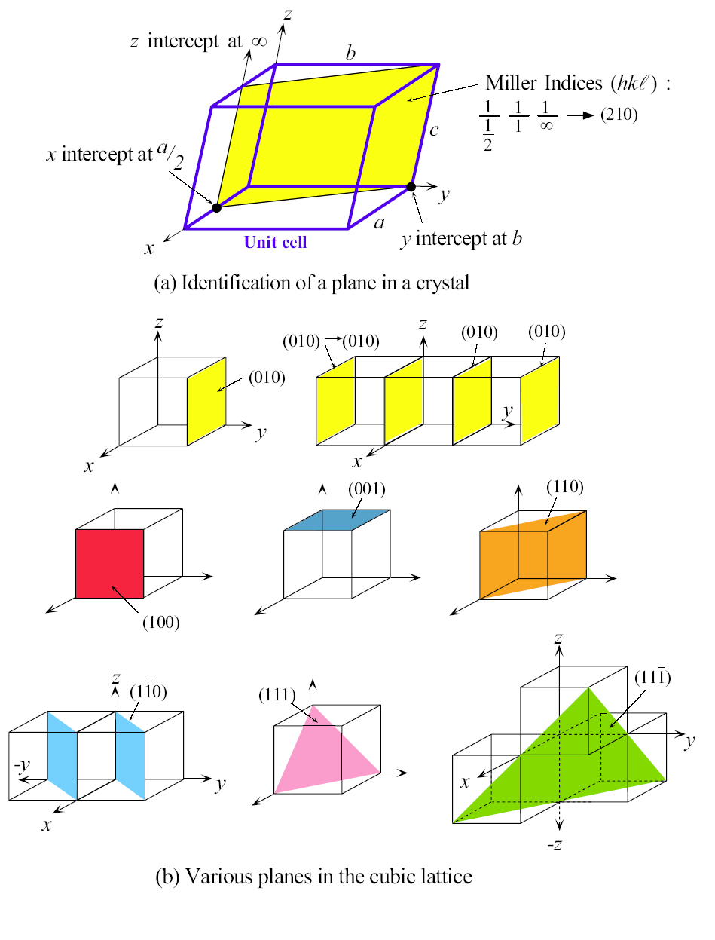
Crystal Planes

Slide 36
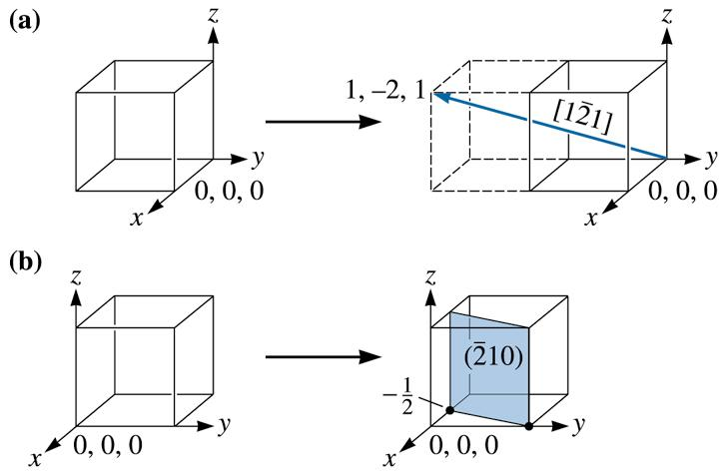
Crystal Planes
Draw the plane in a cubic unit cell.
To draw in the plane, first take reciprocals of the indices to obtain the intercepts, that is:
x = 1/-2 = -1/2 y = 1/1 = 1 z = 1/0 =∝
Since the x-intercept is in a negative direction, and we wish to draw the plane within the unit cell, let’s move the origin +1 in the x-direction to 1, 0, 0. Then we can locate the x-intercept at 1/2 and the y-intercept at +1. The plane will be parallel to the z-axis

